Slide 1
Artificial Intelligence with Natural Language Processing
By
V.Manjuladevi
Mentor- Infosys Trinee

Slide 2
Introduce the topic of AI and NLP
What is AI?
AI (Artificial Intelligence) is the simulation of human intelligence by machines
— especially computer systems.It enables computers and software to think, learn, and make decisions like humans.
what is NLP?
NLP (Natural Language Processing) is a branch of Artificial Intelligence (AI) that focuses on enabling computers to understand, interpret, and generate human language in a meaningful way.

Slide 3
Introduction to AI
Explanation: the capability of machines to perform tasks that typically require human intelligence.
History: From rule-based systems to modern deep learning.
Types:
Narrow AI: Task-specific (e.g., recommendation systems)
General AI: Human-like intelligence (still theoretical)
Super AI: Superior to humans (future concept)

Slide 4
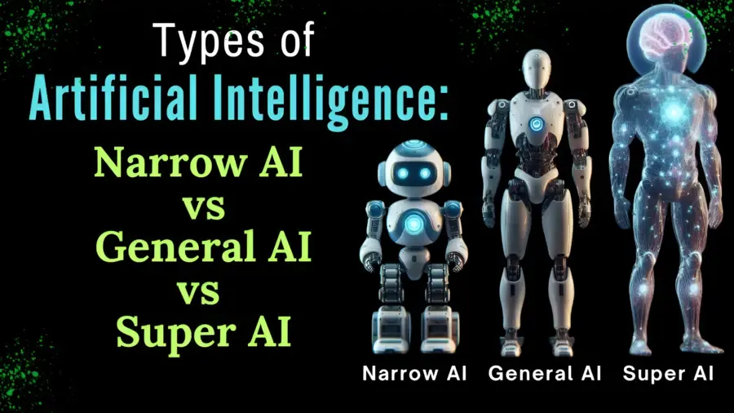

Slide 5
Introduction to NLP
Explanation: NLP is a branch of AI that focuses on understanding, interpreting, and generating human language.
Importance: Enables chatbots, voice assistants, translation systems, and sentiment analysis.
Example: “ChatGPT can generate human-like text and answer questions.”

Slide 6
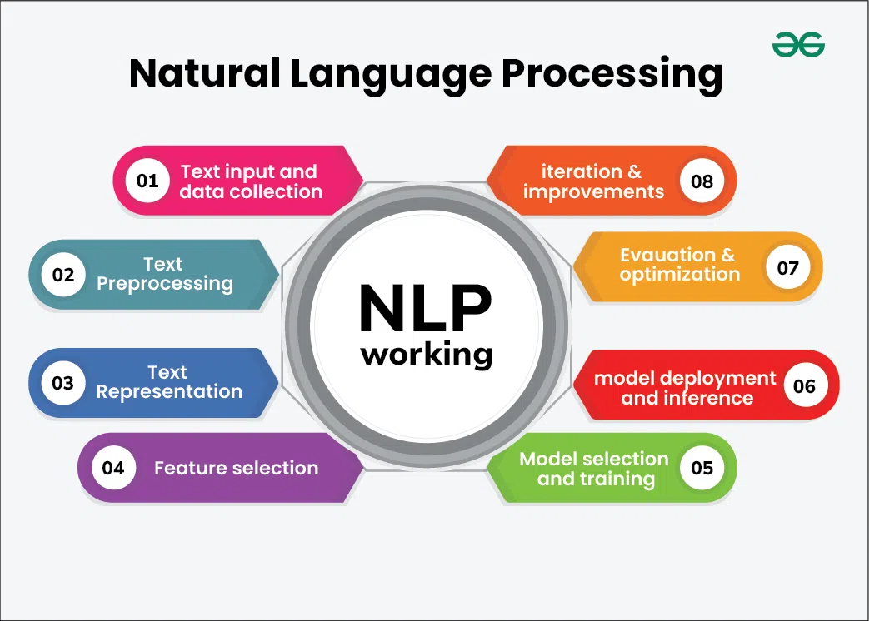

Slide 7
Applications of NLP
Text Analysis: Sentiment analysis on social media or reviews.
Machine Translation: Google Translate, DeepL.
Speech Recognition: Siri, Alexa, Google Assistant.
Chatbots & Virtual Assistants: Customer service, virtual help.
Information Retrieval: Search engines like Google.
Visual: Use icons or diagrams for each category to make it intuitive.

Slide 8
Applications of NLP
Text Analysis: Sentiment analysis on social media or reviews.
Machine Translation: Google Translate, DeepL.
Speech Recognition: Siri, Alexa, Google Assistant.
Chatbots & Virtual Assistants: Customer service, virtual help.
Information Retrieval: Search engines like Google.
Visual: Use icons or diagrams for each category to make it intuitive.

Slide 9
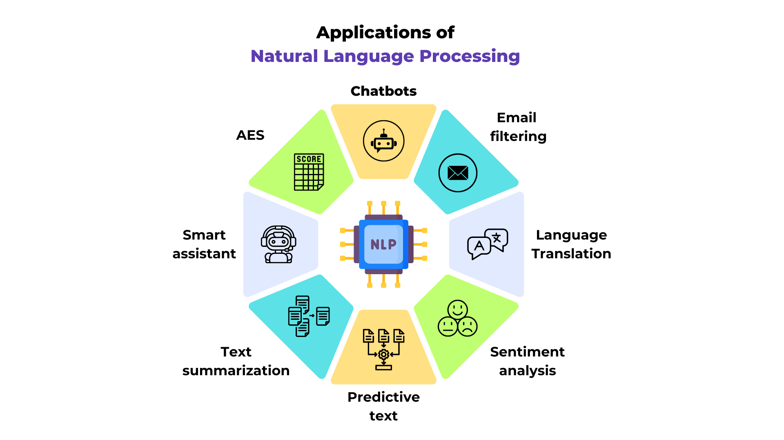

Slide 10
Key Components of NLP
Tokenization: Splitting text into words or sentences.
POS Tagging: Identifying parts of speech (noun, verb, adjective).
Named Entity Recognition (NER): Detecting names, dates, and locations.
Syntax & Parsing: Understanding sentence structure.
Semantics: Understanding the meaning of text.

Slide 11
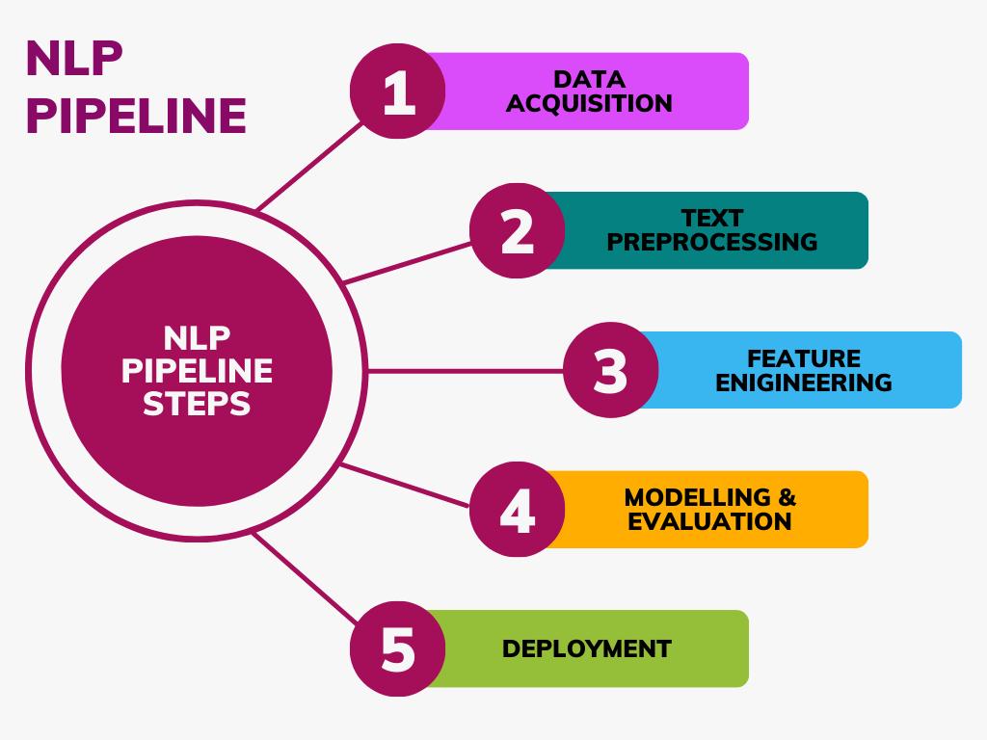

Slide 12
NLP Techniques
Rule-Based Methods: Grammar rules and dictionaries (early NLP systems).
Statistical Methods: N-grams, probabilistic models.
Machine Learning: Supervised and unsupervised models.
Deep Learning: RNNs, LSTMs, Transformers (BERT, GPT).
Visual: Timeline showing evolution of NLP techniques.

Slide 13
Challenges in NLP
Ambiguity: Words can have multiple meanings.
Sarcasm & Idioms: Difficult for machines to interpret.
Multilingual Understanding: Handling different languages.
Context Retention: Maintaining meaning over long texts.
Data Privacy & Bias: NLP systems can inherit biases from training data.

Slide 14
Future of NLP
Conversational AI: More natural chatbots and voice assistants.
Multilingual Translation: Real-time translation without errors.
AI-powered Content Creation: Articles, summaries, reports.
Emotion & Sentiment Detection: Advanced analytics.
Integration with IoT & Robotics: Smarter devices using language understanding.

Slide 15
Examples
ChatGPT: Conversational AI capable of generating human-like text.
Google Translate: Real-time translation system.
Grammarly: Writing assistant that corrects grammar and style.
Amazon Alexa: Voice-based personal assistant.

Slide 16
Thank you

